Slide 1
WEEKLY REPORT AUTOMATION
Company : Norton LifeLock YUVARAJ T
Project Guide : Ms. B. Siva Shankari 2019202063
Mentor : Raja Ganapathy MCA REGULAR

Slide 2
OVERVIEW
DOMAIN :
Web Automation
Web Scraping
Mail Automation

Slide 3
PROBLEM STATEMENT
The weekly report of our Jira Dashboard are created manually at every time . Thus it is created by taking screenshots of the web page and organize manually by my team.
We organize every screenshot and PDF will be created. Lastly, we create a mail with organized structure and we would send that organized mail to our higher officials.

Slide 4
ABSTRACT :
We, at NortonLifelock, designing a tool highly focus on Web Automation and Automated Mailing. This project is to create a Web Automated Tool to automate the IT work to maintain the weekly report of our Jira Dashboard.
This project is to develop script to export the dashboard as PDF for regular interval. This tool is to capture and crop the screenshots of required graphs in the Dashboard page. We have to Scrape the required data from the Dashboard page by Web Scrapping.
Once the required data is captured, it needs to be embedded in the email in specified format. This tool will send the Automated mail with the embedded contents where created above to the required persons.

Slide 5
TOOLS & TECHNIQUES
Programming Language : Javascript
Environment : Node Js
Major libraries will use :
Puppeteer
FS ( File System )
JIMP ( JavaScript Image Manipulation Program )
Node Mailer

Slide 6
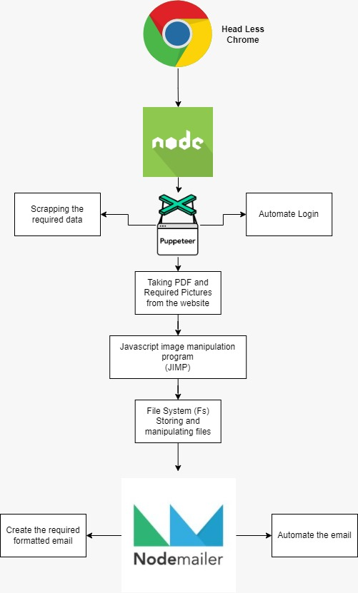
Architecture Diagram

Slide 7
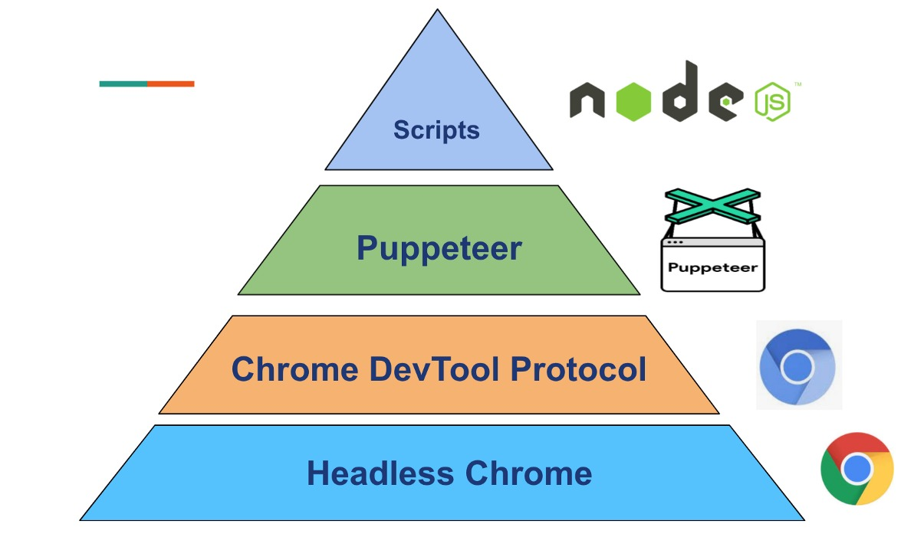
Puppeteer Architecture

Slide 8
MODULES :
Web automation
Scrapping of data
Capturing snapshots
Image manipulation
File system management
Designing the e-mail
Automate the e-mail

Slide 9
MODULE DESCRIPTIONS :
The process of using automated code to extract the required content and data from a website by puppeteer. Automated method is to obtain large amounts of data from websites.
The process of using automated code to extract the required content and data from a website by puppeteer. Automated method is to obtain large amounts of data from websites.
The captured snapshots and PDFs are cropped and edited with the package JIMP (JavaScript Image Manipulation Program)

Slide 10
MODULE DESCRIPTIONS :
The captured images and PDFs are collected, stored and managed in the folder with FS(File System) Package
Design of email is done in this stage with the formatted template. Weekly reported issues are graphed against the solved ones. The photos are formatted in table view
Provided the sender addresses inside the automated code, email is sent with Node Mailer Library

Slide 11
REFRENCES
https://www.nortonlifelock.com/us/en/
https://nodejs.org/
https://pptr.dev/
https://nodemailer.com/about/
https://www.npmjs.com/package/jimp
https://github.com/oliver-moran/jimp
https://nodejs.dev/learn/the-nodejs-fs-module

